Slide 1
An Agile Project Management Model
Highsmith, Jim
Retrieved from Humber library

Slide 2
History
Former Visa International CEO Dee Hock (1999) coined the word “chaordic” to describe both the world around us and his approach to managing a far-flung enterprise—balanced on the precipice between chaos and order. Our sense of the world dictates management style. If the world is perceived as static, then production-style management practices will dominate. If the world is perceived as dynamic, however, then exploration-style management practices will come to the fore. Of course, it’s not that simple—there is always a blend of static and dynamic, which means that managers must always perform a delicate balancing act.
A complex adaptive system, be it biologic or economic, is an ensemble of independent agents:
Who interact to create an ecosystem
Whose interaction is defined by the exchange of information
Whose individual actions are based on some system of internal rules
Who self-organize in nonlinear ways to produce emergent results
Who exhibit characteristics of both order and chaos
Who evolve over time (Highsmith 2000)

Slide 3
History
So is APM new? Well, yes and no. Complexity theory tells us that biological agents evolve by recombining existing building blocks until a different organism emerges. APM involves carefully selecting existing building blocks—practices that have proven useful to project teams in the past—and linking these practices to core values, a set of guiding principles, and a conceptual framework that draws on CAS theory as its foundation. The “combination” of all these building blocks—practices, values, principles, and conceptual framework—results in Agile Project Management. APM draws on a rich project management legacy, but it is very selective about which parts of that legacy it incorporates. APM also draws on a rich legacy of management, manufacturing, and software development literature and practice that incorporates a worldview and ideological foundation better suited to mobility and speed.
In Robert Cooper’s (2001) definition, new product development applies to products that have been on the market five years or less.

Slide 4
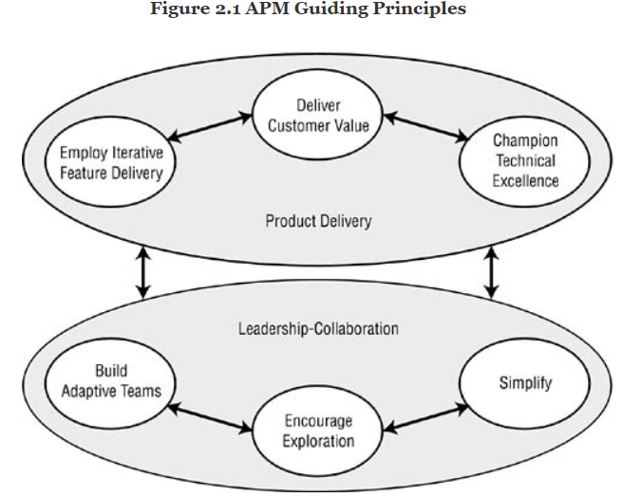
Guidelines: Customer and Product
Customer Value through Innovative Products
Deliver Customer Value
Employ Iterative, Feature-Based Delivery
Champion Technical Excellence
Leadership-Collaboration Management Style
Encourage Exploration
Build Adaptive (Self-Organizing,
Self-Disciplined) Teams
Simplify

Slide 5
Guidelines: customer and Product
DELIVER CUSTOMER VALUE
Innovation and Adaptability
Planning and Control to Execution
Lean Thinking
Necessary Compliance
Delivering Value
EMPLOY ITERATIVE, FEATURE-BASED DELIVERY
Creating a Better Product
Producing Earlier Benefits
Progressive Risk Reduction
TECHNICAL EXCELLENCE

Slide 6
AN AGILE PROCESS FRAMEWORK
The framework needs to:
Support an envision, explore, adapt culture
Support self-organizing, self-disciplined teams
Promote reliability and consistency to the extent possible given the level of project uncertainty
Be flexible and easy to adapt
Support visibility into the process
Incorporate learning
Incorporate practices that support each phase
Provide management checkpoints for review

Slide 7
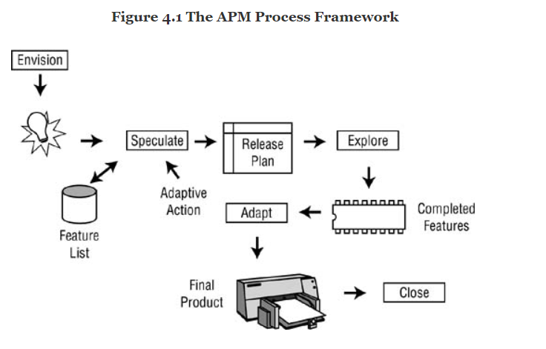
Agile Framework

Slide 8
PHASE: ENVISION
Product Vision
• Product vision box and elevator test statement
• Product architecture and guiding principles
Project Scope (Objectives and Constraints)
• Project data sheet
Project Community
• Get the right people
• Participant identification
• Customer team-development team interface
Approach
• Process and practice tailoring

Slide 9
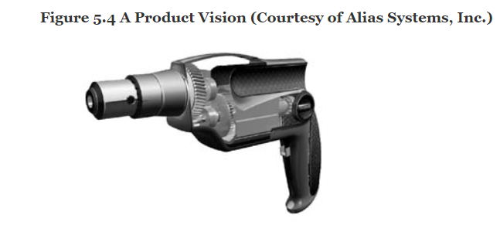
PHASE: ENVISION
Practice: Product Vision Box
The product vision box and elevator test statement galvanize members of the product team into focusing their often disparate views of the product into a concise, visual, and short textual form. These two project artifacts provide a “high concept” of the product for marketers, developers, and managers.
Every product needs a marketing theme, a crisp visual image and feature description whose intent is to draw potential customers into further investigation. In this design-the-box exercise, the project and customer teams, with other participants, create a visual image of the product. (Vision does imply “visual,” after all.) For software and other small products, the image should be the product package. For larger products—automobiles or medical electronics equipment, for example—the vision could be a one- to two-page product brochure or one to two Web pages.

Slide 10
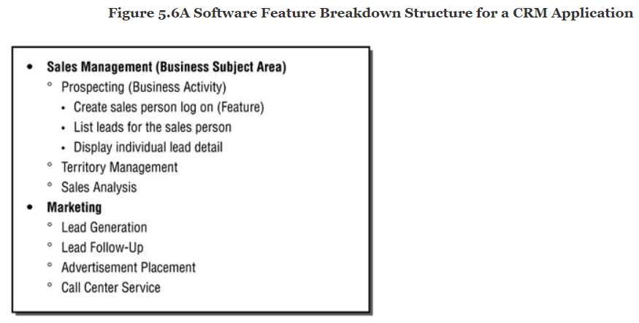
PHASE: ENVISION
Practice: PRODUCT ARCHITECTURE
The objective of product architecture is to depict the internal plumbing of the project—a design that facilitates exploration and guides ongoing product development. Product architecture guides both the technical work and the organization of people who carry out the technical work.

Slide 11
PHASE: ENVISION
PRACTICE: PROJECT DATA SHEET (PDS). The objective of a project data sheet is to convey the essence, in terms of scope, schedule, and resources, of how a project will deliver on the project vision.
Sections of the PDS might include some combination of the following, depending on organization and project type:
• Clients/customers: a list of the key clients or customers
• Project manager
• Product manager
• Project objective statement (POS): a specific, short (25 or fewer words) statement that includes important scope, schedule, and resource information from the tradeoff matrix
• Tradeoff matrix (TOM): a table that establishes the relative priorities of project scope, resources, schedule, and defects—with one and only one of these established as the highest priority
• Exploration factor: a measure (1 to 10) of the risk and uncertainty of the project
• Delay cost: the daily, weekly, or monthly cost of project delay (particularly useful when schedule is the highest priority)
• Features: a list of the key features
• Client benefits: the key benefits and/or selling points of the product
• Performance/quality attributes: a list of the key performance and quality attributes of the product
• Architecture: key architectural components of the product (platform, component, interface, module)
• Issues/risks: factors that could adversely impact this project

Slide 12
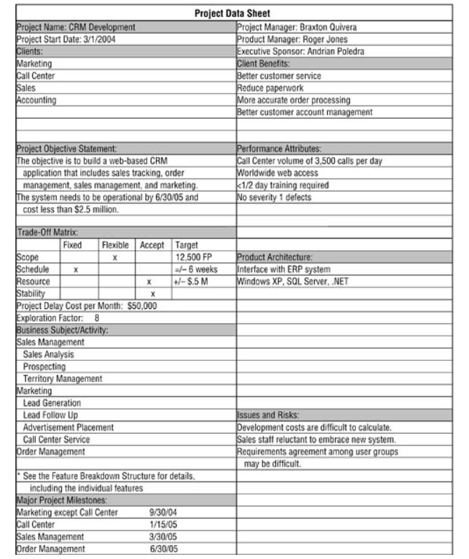
PHASE: ENVISION

Slide 13
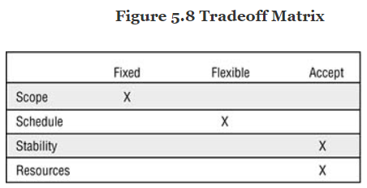
PHASE: ENVISION
Tradeoff Matrix: The tradeoff matrix is an agreement among the project team, the customer (product manager), and the executive sponsor that is used to manage change during the project. The TOM informs all participants that changes have consequences and acts as a basis for team decision making. The key dimensions that create a product’s value—scope, delivery schedule, stability (defects), and resources. The relative importance of each dimension and are labeled Fixed, Flexible, and Accept.

Slide 14
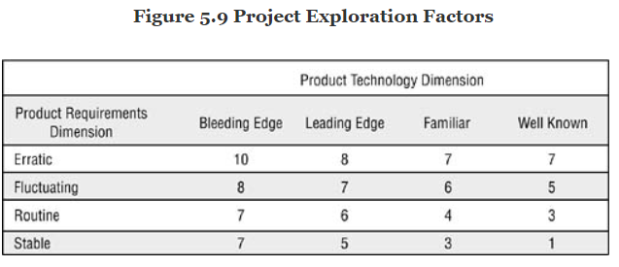
PHASE: ENVISION
Exploration Factor: An exploration factor acts as a barometer of the uncertainty and risk of a project. Big projects are different from small projects; risky projects are different from low-risk ones. One issue in selecting project management practices and processes is the particular problem domain in which the project team has to operate. An exploration factor of 10 indicates a highly exploration-oriented (high-risk) problem domain, and a 1 indicates a very stable problem environment. It is important to identify the various problem domain factors, but it is even more important to tailor processes and practices to the problem and to adjust expectations accordingly.

Slide 15
PHASE: ENVISION
PRACTICE: GET THE RIGHT PEOPLE. The objective of team staffing, and the subsequent organization of teams, can be summed up in four words: Get the Right People. There is a difference between getting the right person and getting the perfect person. Your team may need an expert geophysicist but may not be able to obtain one with the exact skills and experience desired. If you find one with the right self-disciplined attitude and sufficient technical skills, she will figure out how to obtain the right information. If, on the other hand, you find a pharmacologist and expect him to make the jump, that would be wishful thinking. The right person is the one who has the required capability or enough capability to grow—with coaching by the project manager and the team’s technical specialists—into what is needed for the project. Similarly, the right person from a self-discipline perspective will have enough motivation to learn the behaviors that create a well-functioning team.

Slide 16
PHASE: ENVISION
Practice: Participant Identification (PI). The objective of participant identification is to identify all the project participants so that expectations can be understood and managed.
Author Rob Thomsett proposes three levels of participants (whom he calls “stakeholders”), each with a different potential degree of impact on a project:
• Critical: These are the participants who can prevent your project from achieving success before or after implementation; in other words, the showstoppers.
• Essential: These participants can delay your project from achieving success before or after implementation. In other words, you can work around them.
• Nonessential: These participants are interested parties. They have no direct impact on your project, but if they are not included in your communication, they can change their status to critical or essential (Thomsett 2002).

Slide 17
PHASE: ENVISION
PI: Identifying and managing participants has another subtle, but important justification—it helps improve teamwork.
A list of project participants might include:
• Executive sponsor: the person (or group of people) who champions the product and makes key decisions about the product’s goals and constraints
• Project manager: the person who leads the team charged with delivering the results
• Product manager: the person who leads the team responsible for determining what results to deliver
• Lead engineer: the person who guides the technical aspects of the team’s delivery
• Management: a potentially wide range of individuals who can be in charge of participant organizations; may have budget or technical decision-making authority or influence over the project outcomes
• Customer team: the individuals, both full and part time, who are charged with determining features that need to be built and prioritizing them
• Project team: the individuals, both full and part time, who are charged with delivering results
• Suppliers: external companies or individuals who provide services or product components
• Government: regulatory agencies that require information, reports, certifications, and more

Slide 18
PHASE: ENVISION
CUSTOMER TEAM-DEVELOPER TEAM INTERFACE. The objective of this practice is to define the collaboration interface between the customer team and the development team.
Every project should have a project manager and a product manager. One of the key reasons internal IT projects fail, or underperform, is misunderstanding the nature of these two roles. Product groups often do a decent job of differentiating these roles, but IT projects often miss the product manager role. At one level the responsibilities of the product manager and project manager are simple—the first is responsible for “what to build” and the second for “how to build it.” In practice each role, each person, has input and influence on the entire project—both the what and the how.
This brings up another wider issue. Roles are not static descriptions that we slavishly follow; roles are instantiated by individuals, and every person who fills a role plays it differently. Just as every actor playing Macbeth brings his own talents, interpretation, and experience to the play, every person who fills a product or project manager role (or any other role) plays it differently. One product manager may have extensive technical experience, another less. To tell the first person that she shouldn’t have any input to the technical decisions would be throwing away a valuable resource. To tell a product domain-experienced project manager or developer that he will have no input to the product vision or specifications would be an equal waste of talent.

Slide 19
PHASE: ENVISION
CUSTOMER TEAM-DEVELOPER TEAM INTERFACE. Getting back to the interface issues, there has long been a controversy in IT circles about where project managers should come from—customer or IT departments. Because of failed interactions on projects, companies have attempted to push project responsibility onto the customer by having someone from the customer organization be the project manager. Unfortunately, these individuals often don’t have the time, project management skills, or technical knowledge required for the job. The real customer-developer problems get lost in this shuffle, because there is no differentiation between product and project management. All too often customer-side project managers try to do the job of both project manager and product manager in addition to their full-time job and end up failing at all three. For a small project, the product manager may also be the primary customer. For an IT project for which there are ten customer departments, spread across six cities, with 150 users providing requirements input, a product manager should be appointed to coordinate the customer information flow and decision making. For a product development organization, the product manager—who often resides in the marketing department—coordinates the gathering of information from thousands or even millions of retail customers, condenses them into a usable form, and then coordinates the decision-making process.

Slide 20
PHASE: ENVISION
CUSTOMER TEAM-DEVELOPER TEAM INTERFACE. The responsibilities of each group and the interactions between the two groups are key to success. In the early Envision stage of a project, both groups are involved in creating a product vision, but the product manager is responsible for the final decisions. During the Speculate and Explore phases, the groups interact to analyze requirements, to identify features, and then to prioritize those features into development iterations. Customers define feature requirements and help the project team make day-to-day refinements. Larger projects may have many customers, who often have conflicting needs and priorities. No single person may have knowledge of all the feature requirements. For these larger projects, or for projects with wide-ranging needs for customer information, it is important to consolidate multiple voices into a consistent “customer voice,” a task that is ultimately the product manager’s responsibility.
Without a strong product manager, the worst situation arises—prioritization fails, and the development team, in order to keep the project from bogging down, begins making the priority decisions itself. This degenerates into a no-win situation, as the customers can always fault the decisions and then use that failure as an excuse to reduce their involvement further. When a project loses its partnership relationships and parties abdicate their responsibilities, that project is in big trouble. This problem sometimes occurs in companies because product managers tend to wear both a marketing hat and a development hat. The marketing role takes up so much time that they have little left over for working with development.

Slide 21
PHASE: ENVISION
CUSTOMER TEAM-DEVELOPER TEAM INTERFACE. As with many other practices, defining the customer-developer interface presents different challenges when you are using it with a team of 10, or 100, or 1,000. Trying to corral 100 customers from disparate business departments is much more difficult than working with a single one. Similarly, working with a group of 100 engineers creates more headaches than working with 2. However, the basic interactions shown in the customer-developer interface diagram and the responsibilities of the roles as described above don’t change with size. The means to the ends will be different, but the outcomes should be consistent.

Slide 22
PHASE: ENVISION
Practice: Process and Practice Tailoring. The objective of this practice is to tailor a process and practice framework—driven in part by a self-organization strategy—that defines the approach the team members will take in working together.
Process and practice tailoring defines the approach that the project team will use to deliver a product. This approach starts with the organization’s standard framework, and then the project manager and team tailor it to their needs within the framework’s constraints. For example, a company might use the APM high-level process framework with organizationally mandated checkpoints (approvals) at each phase. Within this process framework, the company identifies a set of required practices and deliverables (a streamlined set). The team then tailors the required practices and adds additional ones it deems necessary.
Self-organization strategy concentrates on how people work together, how they collaborate, and the mechanisms for that collaboration. Processes and individual practices concentrate on what people actually do. Although the strategy and process seem to overlap, they are actually complementary. For example, the practice of daily team integration meetings describes the concepts and mechanics for conducting short daily meetings to coordinate team activities. But if there are multiple subteams, the project needs a strategy for using these meetings effectively in larger groups.
Finally, processes and practices evolve. In the Envision phase the team may develop a general plan for its use that will undoubtedly be revised as the release plan details are developed in the Speculate phase. Then, as each iteration and milestone reaches completion, the processes and practices will be adapted to the feedback from the project itself. Nothing is static in APM—neither the product nor practices. Teams are encouraged to adapt everything except the bare essential policies and process framework to the reality of the actual situation as it unfolds.

Slide 23
PHASE: ENVISION
Process Selection and Tailoring: There should always be a discussion about how to approach each iteration; what was done in one may not be required for the next one. With individual practices, each team will tailor them in different ways according to the capabilities of the team members, the size of the project, the number of customers, and many other factors.
There are four fundamental questions the team should ask itself about the practices they select and tailor for a particular project:
What practices are required?
What supplementary practices do we need?
What modifications do we need to make to the selected practices?
What level of formality or ceremony should be used for documentation, approvals, changes?
Early Planning: There are always activities that need to be identified, and often planned, prior to the Explore phase. For example, end-of-iteration customer focus group reviews require the attendance of customers who may not work with the project team on a day-to-day basis. It therefore behooves the project team to schedule these review sessions early (at least for the first three to four months). Waiting until a few weeks before the session to invite participants usually results in poor attendance. The team needs to review all of the practices in the Speculate and Explore phases to ascertain if any “preplanning” needs to occur.

Slide 24
PHASE: SPECULATE
The product of the Speculate phase is a release plan that outlines, to the best of the project team’s initial knowledge, a plan that is based on features delivered rather than activities. The release plan utilizes information about the product’s specification, platform architecture, resources, risk analysis, defect levels, business constraints, and target schedules. There are two crucial components of an iterative planning and development approach—short iterative timeboxes and features. For software projects, iterations are generally two to six weeks in length. Hardware projects will have longer iterations and greater variation—electronic devices will generally have shorter timeboxes than, say, automobiles. Short iterations act to accelerate projects. By keeping timeframes short, teams have to figure out faster ways of accomplishing every aspect of development. For example, in serial development, major quality assurance activities are performed once toward the end of the project. In iterative development, QA activities are completed every iteration. The QA staff has to figure out how to be more effective and efficient because they perform these activities six, eight, or ten times rather than once. Feature-based development is not a software-only technique. Many hardware product development efforts are driven by first creating a product structure and then an extensive list of the features. In addition, since more and more products include embedded software, hardware and software features are both candidates for this feature-driven approach. The first goal of feature-based planning and development is to make the process visible, and understandable, to the customer team.

Slide 25
PHASE: SPECULATE
Agile project speculating helps the project team:
Determine how the product and its features will evolve
Balance anticipation of features and design with adaptation as the project unfolds
Focus on the highest-value features early in the project
Think about the project, business goals, and customer expectations
Provide necessary budget and schedule information to management
Establish priorities for tradeoff decisions as changes occur
Coordinate interrelated activities and features across feature teams
Consider alternatives and adaptive actions
Provide a baseline for analyzing events that occur during the project

Slide 26
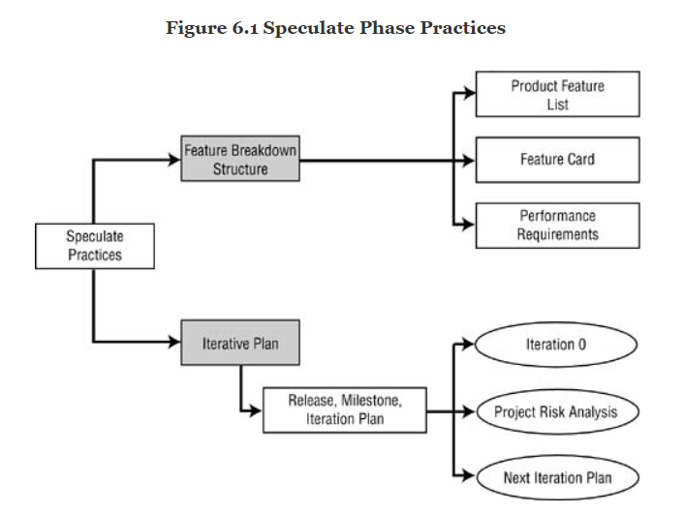
PHASE: SPECULATE
Feature Breakdown Structure
Product feature list
Feature cards
Performance requirements cards
Release Planning
Release, milestone, iteration plan

Slide 27
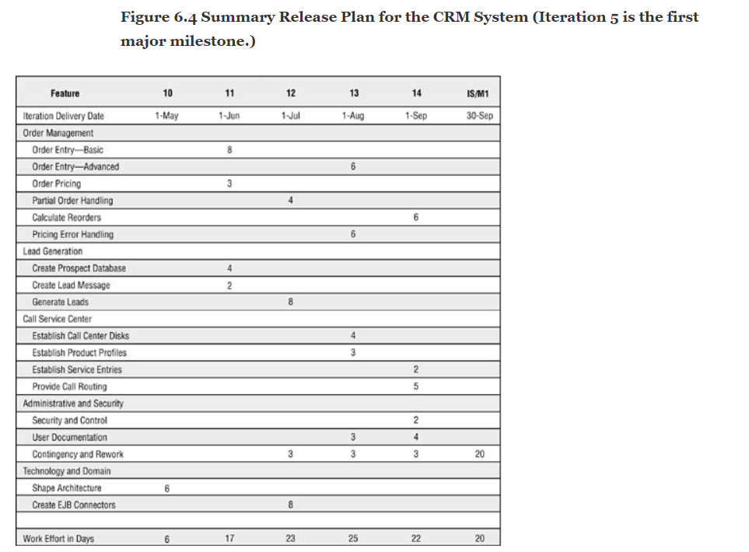
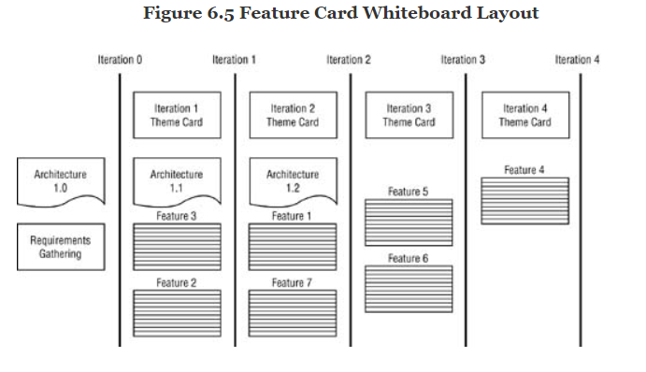
PHASE: SPECULATE

Slide 28
PHASE: SPECULATE
PRACTICE: PRODUCT FEATURE LIST. The objective of this practice is to expand the product vision, through an evolutionary product requirements definition process, into a product feature list (similar to a manufacturing parts explosion list).
A product feature list, an expansion and refinement of the one developed in the Envision phase, identifies and documents the features gathered for a product from feasibility or marketing studies, initial requirements-gathering efforts, and/or product visioning. For existing products, customers, developers, product managers, and customer support staff are constantly making suggestions about product enhancements. Part of a product manager’s job is to constantly sift through this list and sort it (with customer involvement) into priority order. This list and the accompanying feature cards are the major inputs for release, milestone, and iteration planning.

Slide 29
PHASE: SPECULATE
So what is a feature anyway? In general, a feature is defined as a piece of a product that delivers some useful and valuable functionality to a customer. Features for a software product (the ability to check a customer’s credit rating) or an airplane (a comfortable seat for the passenger) will be very different, but they both focus on delivering value to the customer. In planning a product, however, some items that need to be delivered may not sound—at least to customers or product managers—as though they provide direct benefit. An interface component deep in the bowels of an electronic instrument may have minimal interest for an end customer but be a necessary “technology domain” feature.
From the list of potential features, the product team and the engineering team will discuss prioritization and scheduling issues during the assignment of features to development iterations. One characteristic of APM projects is the volatility of the features on this list. For a more sedate project in which the requirements are firmly established in the beginning, this feature list becomes the input for a plan that becomes relatively fixed. In an agile project, the use of the list is much more dynamic. During the planning for each iteration, the list of features to be included in that iteration can change significantly from the original release plan.

Slide 30
PHASE: SPECULATE
PRACTICE: FEATURE CARDS. The purpose of feature cards is to provide a simple medium for gathering basic information about features, recording high-level requirements, and developing work estimates. Feature-based development is intended to be customer-facing development. Feature cards are used to identify, but not to define, features. Feature cards2 act as agreements between customers and project team members to discuss (and document, to the extent necessary) detail requirements during an iteration. Discussion is critical to understanding, which in turn is critical to estimating. Feature cards identify features that the customer wants in the product. For large products, hardware component or business activity “group” cards (from the feature breakdown structure, or FBS) can be used to organize and plan individual feature lists. A group card may encompass 10, 15, or even 20 detail features.

Slide 31
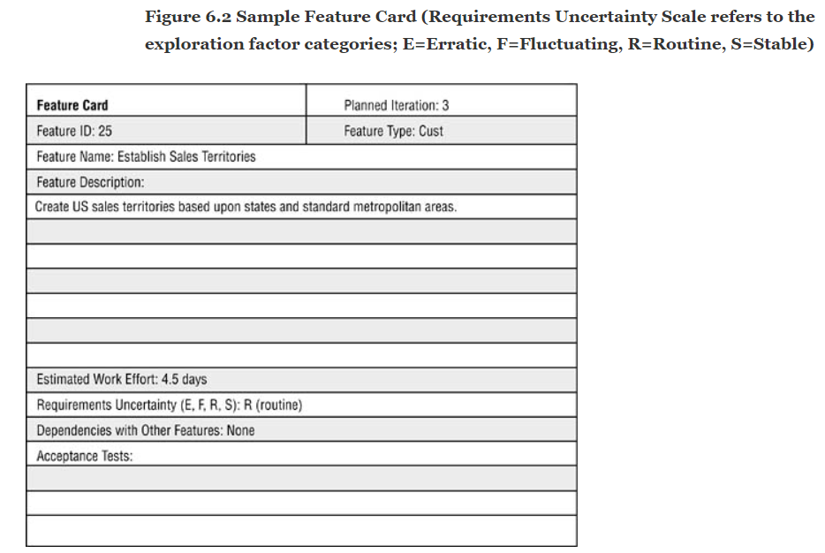
PHASE: SPECULATE
Typical items on feature cards are:
• Feature identifier and name• Feature description: a sentence or two that describes the feature in customer terms• Feature type (C=customer domain, T=technology domain)• Estimated work effort: the estimated work effort needed to deliver the feature, including time for requirements gathering, design, coding, testing, and documentation3• Requirements uncertainty (erratic, fluctuating, routine, stable): an “exploration factor” for a specific feature• Feature dependencies: dependencies that could influence implementation sequencing• Acceptance tests: criteria the customer team will use to accept or reject the feature4

Slide 32
PHASE: SPECULATE
PRACTICE: PERFORMANCE REQUIREMENTS CARDS. Performance requirements cards document the key operations and performance requirements of the product to be built.
While some performance requirements could be defined on a feature card and others could be covered as acceptance tests on a feature card, there are many situations in which a distinct, and very visible, definition of performance and operational requirements is necessary. For example, myriad design decisions—in fact the major design decisions—in aircraft design revolve around weight. Weight isn’t a function of a single feature, avionics or engines, but a property of the entire plane. Similarly, the expected load on an Internet site is a function of the site, not an individual feature. In these cases it would be inappropriate to have the performance requirement be an acceptance test for an individual feature, although in the case of aircraft design, each subsystem team is given a weight target. If subsystems are too heavy, teams must coordinate by trading weight credits and negotiating other performance criteria.

Slide 33
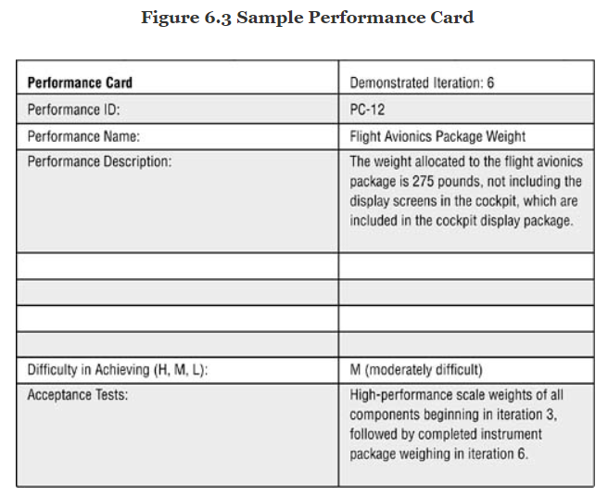
PHASE: SPECULATE
A card might be labeled, say, “Database Size” or “Aircraft Weight Limit” or “Training Time.” Teams should focus on those performance attributes that will drive the design process. For example, weight, payload, range, and speed are critical aircraft design parameters; each would have a performance card (obviously backed up by more extensive documentation). Performance cards should also contain acceptance tests—how the team will demonstrate to the customer team that the product meets the performance criteria. These tests are essential when the performance criteria to be met involve critical real-world risks (e.g., planes falling out of the sky). Since some tests are very difficult to run until the product is fully built, creating interim tests (using simulations, prototypes, models, or historical calculations) should be considered.

Slide 34
PHASE: SPECULATE
Practice: Release, Milestone, and Iteration Plan. A release, milestone, and iteration plan presents a roadmap of how the project team intends to achieve the product vision within the project scope and constraints identified in the project data sheet.
Agile lifecycles are both iterative and feature driven. The feature-driven aspect changes the primary focus of planning and executing from tasks to product features. Most traditional project management plans utilize tasks to construct work breakdown structures (WBSs) to organize work. Although experienced project managers concentrate first on deliverables and then on the work necessary to create those deliverables, work- or task-driven plans often degenerate into very detailed, prescriptive plans. Any product has a set of features that customers use for some purpose. The more quickly we can link those customers with the features they have requested and get feedback on them, the more likely the product development effort will be successful.

Slide 35
PHASE: SPECULATE
However, many project managers can’t fathom a twelve-month project broken down into two-week iterations, which is understandable. Once projects go beyond four to five months, project participants usually need interim checkpoints between two-week intervals and the project’s end. Larger projects that employ distributed teams or vendor-supplied components will have problems synchronizing every two weeks. Therefore many projects will require three levels of iteration. The longest period is the release cycle. Products are generally released to customers periodically—for example, once every year or eighteen months.
Iterations produce acceptance-tested features. The goal is to have a partial-feature product that could be deployed at the end of any iteration—that is, the features, tests, documentation, and other product deliverables could be packaged up and deployed. Actual deployment of the iterative results—referred to as incremental delivery.
A development team uses an iteration to concentrate on small increments of work. In software development, an iteration might be two to six weeks or slightly longer for some projects. If you’re building an airplane, the iterations will surely be longer (although early prototype analysis might use very short iterations). Features developed within a feature team (usually fewer than ten people who work on a group of features) should be integrated and tested by the end of the iteration.

Slide 36
PHASE: SPECULATE
Milestones are intermediate points, usually from one month to three months apart. Milestones can have both a project management function and a technical function. From a project management perspective, milestones provide a chance to review progress and make significant project adjustments. While some reviews should occur every iteration (e.g., a customer team review of the product), others might be appropriate at the end of a milestone (e.g., a mini-retrospective of the team’s performance).
Some components will invariably take longer, or appear to take longer, than one iteration to complete. Usually when teams are pressed to decompose a “big” component into bite-sized features, they figure out a way. Inability to break things down in this manner is usually an issue of lack of experience rather than a un-decomposable component. However, in the unusual situation in which a component’s development spans two or more iterations, the project manager and team need to keep in mind the added risk involved in delaying customer feedback on it.

Slide 37
PHASE: SPECULATE
Iteration 0.
A project to develop a large business software application, one that must be integrated with other business applications, may require some data architecture work in order to adequately define the interfaces with those other applications. In the case of an electronic instrument, the team might find it useful to create a preliminary componentization architecture. Teams utilizing unfamiliar technology may need time for training prior to a project’s launch. A customer may demand a requirements document prior to signing a contract. All of these examples indicate a need for some time expenditure prior to launching into actual iterative feature development. For each of these items, a feature card (which will usually contain an artifact—a shape architecture diagram, for example—rather than an implementable feature) should be created and placed in iteration 0. The need for an iteration 0 will usually be obvious before the project gets underway and will be planned as part of the Envision phase. While the relevant issues may vary, the outcome is the same—some projects require more extensive initialization work than others. The key to effectively utilizing iteration 0 is to balance the possible advantages of further planning with the growing disadvantage of lack of customer-deliverable features. There are always tradeoffs. If the cost of a technical platform change is very high, then additional work to improve the odds of a correct initial decision may be justified. The timeframe of an iteration 0 for a next-generation jumbo jetliner will be much different than that for a portable CD player.

Slide 38
PHASE: SPECULATE
Iterations 1–N
The activities involved in laying out the iteration plan include:• Determining how identified risks will influence iteration planning• Identifying the schedule target• Establishing the milestone and iteration periods• Developing a theme for each iteration (or milestone)• Assigning feature cards to each iteration, balancing customer priorities, risks, resources, and dependencies as necessary• Summarizing the plan in some combination of a feature-level spreadsheet plan, a feature card layout (usually on a wall), or a project parking lot • Calculating an initial project schedule from staff availability and total feature effort estimates• Adjusting the completed plan as necessary

Slide 39
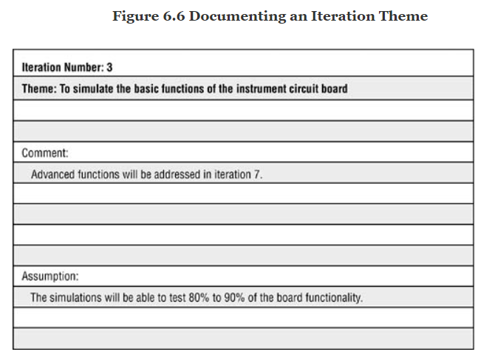
PHASE: SPECULATE
Depending on the degree of project uncertainty, teams might develop:
• A complete plan with features assigned to every iteration
• A two-iteration plan utilizing only a next iteration and then everything after
• An iteration-by-iteration plan
Once the overall release plan has been established for the entire project, the team returns to develop a detail plan for the next (or the first, if it’s the beginning of the project) iteration. The team takes each feature card and constructs a list of the technical activities required to implement the feature and records the activities on the back of the card. The team then reestimates the work effort based on the more detailed assessment and adjusts the features planned for the iteration if necessary.

Slide 40
PHASE: SPECULATE
First Feasible Deployment.
Since there are significant benefits to early product deployment, one thing a product team can do is determine a first feasible deployment (FFD); that is, the first iteration in which the product could potentially be deployed. For example, a company might be able to deploy early versions of a product to key customers who have been asking for such a product. The customers understand that the product only has certain features, but they are willing to work with that limited functionality. For the development team, early deployment might bring in both revenue and helpful product feedback. Early deployment has certain benefits but also potential costs, and high deployment costs would offset some of the benefits. Teams contemplating an early deployment strategy need to think about it during initial release planning, as feature scheduling may be impacted. For example, an early deployment strategy might suggest scheduling all of the features in a particular area early such that the product would be rich enough in that one area to deploy. In the absence of an early deployment strategy, implementing features across functional areas might work as well or even better. Early deployment and beta test strategies also need to be considered together.

Slide 41
PHASE: SPECULATE
Estimating.
There are three subtleties underlying the “how to estimate” question:• How to estimate the unknown• How to estimate by features rather than activity• How to do progressive estimation
First, since agile methods are often used for high exploration-factor projects, the critical estimating question becomes “How do you estimate the unknown?” and the answer is “You can’t.” When there are unknowns, you are guessing, not estimating—and it’s the best we can do. This is one reason why time and cost are often viewed as constraints, not estimates, in agile projects. Agile organizations learn to live with uncertainty rather than trying to demand certainty in a fast-changing world.
Second, agile projects are planned by features, whereas many project managers may be more familiar with task-based estimating. These managers have to learn to apply their experience to estimating tasks for each feature. For example, rather than estimate requirements gathering for an entire project, they will be estimating it on a feature-by-feature basis. Teams members who have spent several days identifying features and assigning them to iterations usually have a much better understanding of the product than those who have relied on task-based planning. So in most cases, feature-based planning provides better estimates.
Third, good project managers have always tried to employ progressive estimation practices (e.g., completing requirements definition prior to estimating the rest of the project), but they are often stymied by organizational demands for early numbers for budgeting purposes. Teams practicing APM can provide similar estimates for such purposes, but APM is fundamentally a progressive estimating and delivery process that mirrors the actual way product information unfolds over time.

Slide 42
PHASE: SPECULATE
Scope Evolution
Agile development is about focus and balance—focusing on the project’s key vision and goals and forcing hard tradeoff decisions that bring balance to the product. Agile development plans by feature, in customer terminology, thereby concentrating the planning process on something the customer can relate to and prioritize easily. Because plans are adjusted each iteration based on actual development experience, not someone’s guesses or wishes, nice-to-have features are pushed into later iterations and are often eliminated completely.
A product’s scope should be driven by customer value, technical feasibility and cost, the impact on a product’s adaptability, and critical business schedule needs. It should not be held hostage to a plan developed when our product and project knowledge was still in its infancy.
The short iterations in agile development, combined with end-of-iteration customer reviews, make the entire team—developers, customers, and managers—face reality. We can take a requirements document and “estimate” how long it will take to develop and test the code, or we can build a small set of features and measure how long it actually took to develop them. “Yes, we estimated that we could implement 25 features this iteration, but in reality, we only delivered 15. Now what?” We now have to drop features, add staff, and/or extend the project time. Note that we do this early in a project when there is still time to compensate. Traditional approaches delay these difficult decisions until the point at which adaptive action is nearly impossible. Short-cycle reality checks keep featuritis from getting out of hand.
Short iterations also keep developers focused. With a deadline approaching every few weeks, the tendency to “enhance” features diminishes. The prioritization previously discussed emphasizes reducing the number of features undertaken. Short iterations then act to limit the size of those features. Agile practices incorporate change into the development process, while at the same time reducing project size by constant and intense concentration on essentials.

Slide 43
PHASE: SPECULATE
Risk Analysis and Mitigation
Since APM was designed to handle high-risk, uncertain product development projects, a separate risk analysis may seem redundant. Redundant or not, it is crucial that risk analysis and mitigation become an integral part of every APM phase and process.
In Waltzing with Bears, their book on software risk management, Tom DeMarco and Tim Lister identify five core risks that dominate software projects: 1. Inherent schedule flaws 2. Requirements inflation (creep) 3. Employee turnover 4. Specification breakdown 5. Poor productivity
APM techniques that address schedule risk are:• Heavy team involvement in planning and estimating• Early feedback on delivery velocity• Constant pressure to balance the number and depth of features with schedule constraints• Close interactions between engineering and customer teams• Early error detection/correction to keep a clean working product

Slide 44
PHASE: SPECULATE
Agile development targets risky projects—those with high levels of uncertainty and short delivery schedules. Understanding the risks, within the context of a particular project, requires experience. Mountain climbers who get into the most trouble are those who don’t understand the risks. Experienced mountaineers know their limits; they have a sixth sense about when to continue on—because getting to the top of major peaks requires pushing oneself and one’s team to the edge, but not over the edge—and when to turn back. Project teams and managers need to be visionary and positive, and at the same time, brutally honest about the risks. For project teams operating at the edge on highly risky projects, there are no formulaic answers to managing risk. APM requires the project manager to stand back from the process and constantly ask questions and monitor the situation to get answers sooner rather than later.
Risk management is a tricky proposition for project managers. On one hand, they must be realistic about the dangers facing the project—denial leads to surprise, which leads to last-minute scrambling and firefighting. On the other hand, constantly harping on risks can demoralize a team. There are so many difficult questions about product development: Will it sell? What exactly do the customers want? What are our competitors doing? Can we deliver it on time? Can we build it for the target cost? Will the new electronic control system be ready in time? And on and on. The project leader needs to project confidence in the positive outcome of the project without glossing over the dangers. Like most of the other aspects of leadership, risk management is a delicate balancing act.

